Slide 1
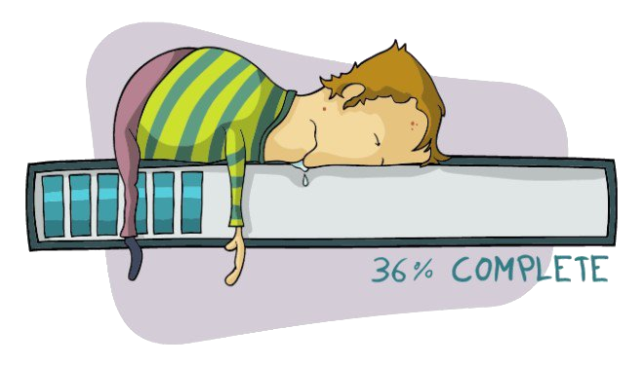
Data oriented approach to C++

Slide 2
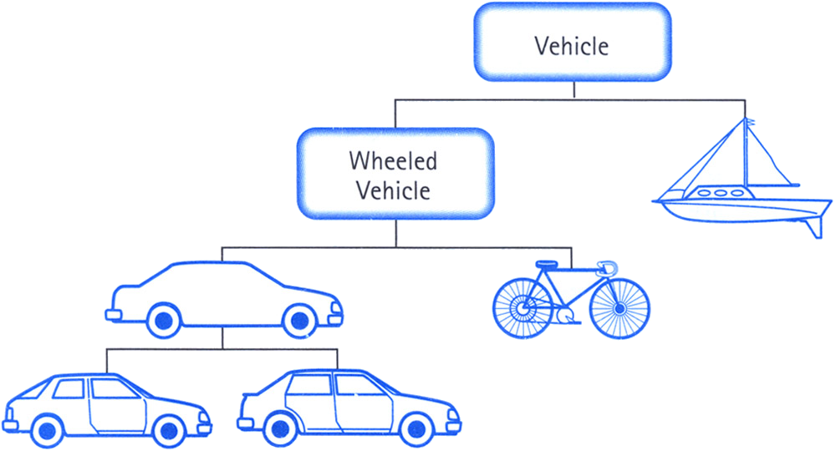
Object oriented C++ and virtual world

Slide 3
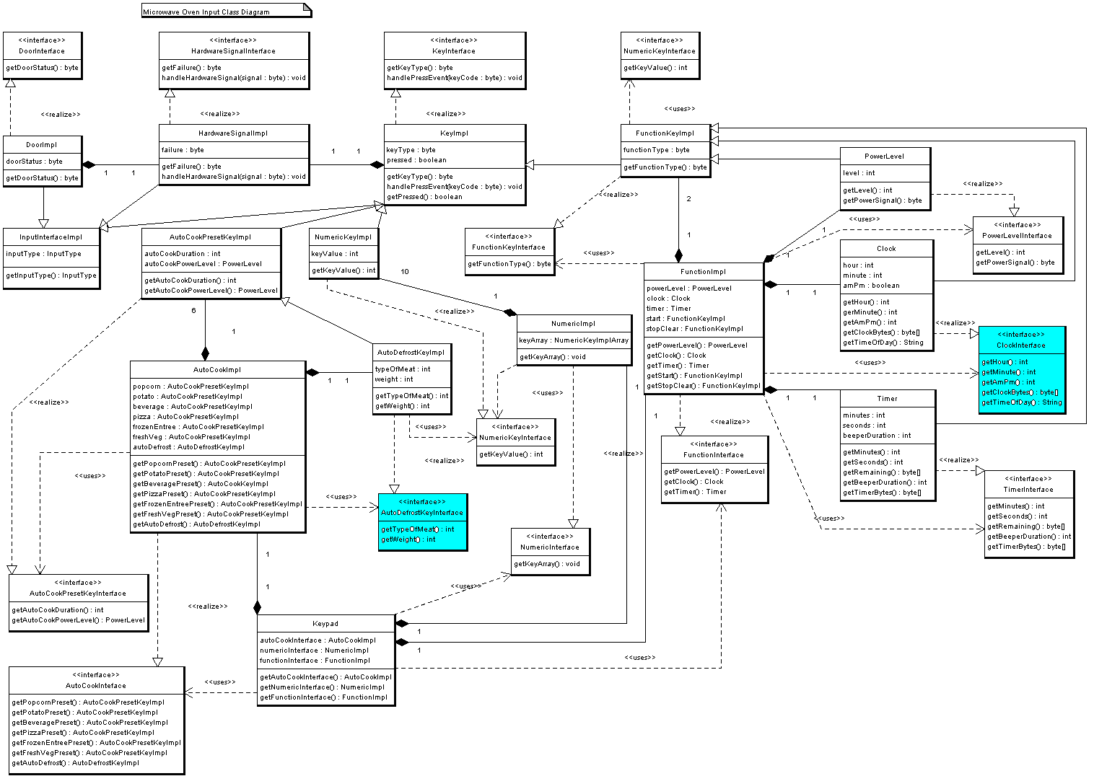
The actual world

Slide 4
What issues do arise?
Unrelated data is grouped together
Monolithic classes and structures
Unmaintainable code-base
Poor debuggability
Poor performance

Slide 5
What happens next
Let’s build more abstractions
Let’s introduce more complexity
Let’s introduce more indirection
Let’s image that hardware is not a limit
Let’s pretend that poor performance is a
FEATURE

Slide 6

And the reaction from the customer is

Slide 7
So what can we do?
Separate unrelated data
Reduce complexity
Remove data indirections
Understand the hardware we work on
Profile and benchmark all the time

Slide 8
What can we learn
Software cannot be designed around the model of the world
Resources on the target platform is the key
CPU does not respect your wishes
Working against hardware gets you
NOWHERE

Slide 9
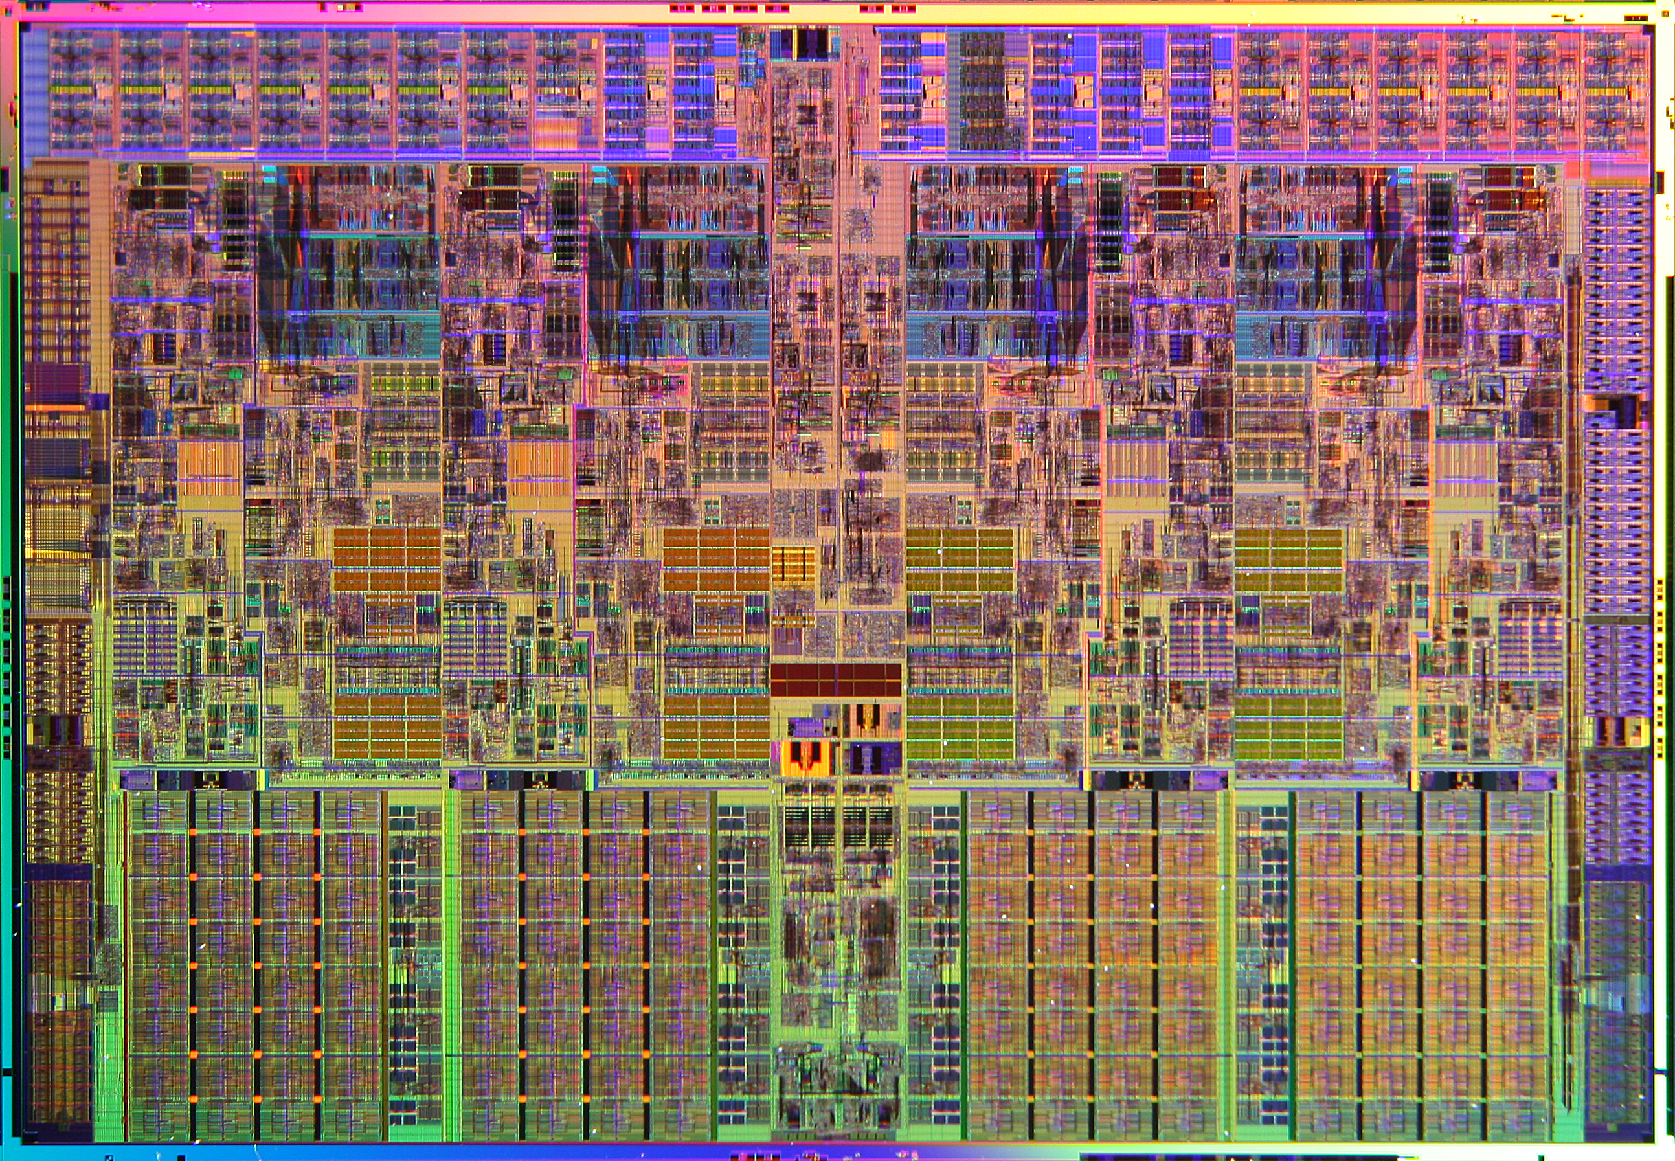

Slide 10
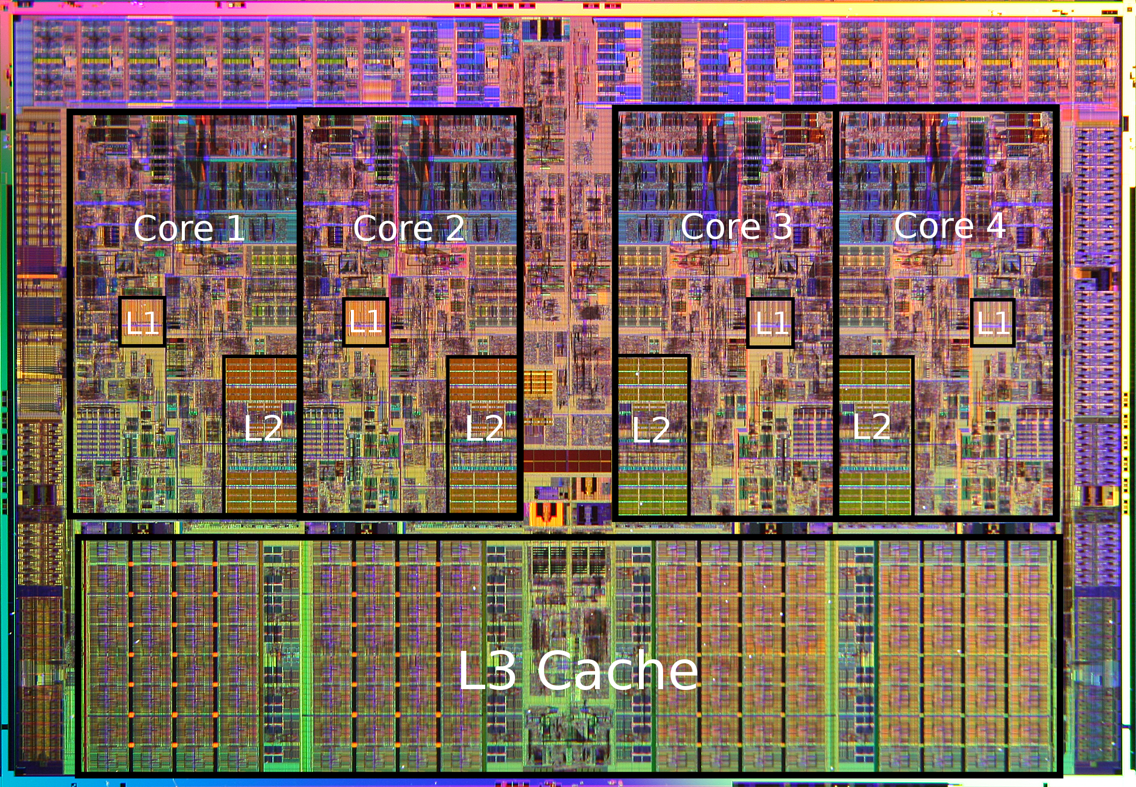

Slide 11
Access cost on X86_64
L1 cache reference 0.5 ns
Branch mispredict 5 ns
L2 cache reference 7 ns 14x L1 cache
Mutex lock/unlock 25 ns
Main memory reference 100 ns 20x L2 cache, 200x L1 cache
Compress 1K bytes with Zippy 3,000 ns 3 us
Send 1K bytes over 1 Gbps network 10,000 ns 10 us
Read 4K randomly from SSD* 150,000 ns 150 us ~1GB/sec SSD
Read 1 MB sequentially from memory 250,000 ns 250 us
Round trip within same datacenter 500,000 ns 500 us
Read 1 MB sequentially from SSD* 1,000,000 ns 1,000 us 1 ms ~1GB/sec SSD, 4X memory

Slide 12
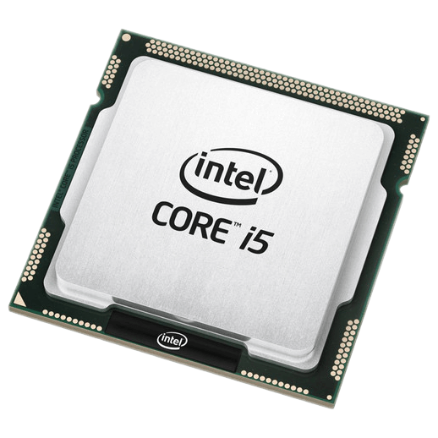
Cache miss cost
L1
L2
RAM

Slide 13
What about my compiler, can it help?
Instruction | Latency
SQRTSS/PS | 10-14
VSQRTPS | 21-28
SQRTSD/PD | 10-21
VSQRTPD | 21-43

Slide 14
https://deplinenoise.wordpress.com/2013/12/28/optimizable-code/
class Object {
float m_Pos[2];
float m_Velocity[2];
char m_Name[32];
Model* m_Model;
// ... other members ...
float m_Foo;
void UpdateFoo(float f)
{
float mag = sqrtf(
m_Velocity[0] * m_Velocity[0] +
m_Velocity[1] * m_Velocity[1]);
m_Foo += mag * f;
}
};

Slide 15
_ZN6Object9UpdateFooEf:
.LFB2297:
.cfi_startproc
pushq %rbp #
.cfi_def_cfa_offset 16
.cfi_offset 6, -16
movq %rsp, %rbp #,
.cfi_def_cfa_register 6
subq $32, %rsp #,
movq %rdi, -24(%rbp) # this, this
movss %xmm0, -28(%rbp) # f, f
movq -24(%rbp), %rax # this, tmp97
movss 8(%rax), %xmm1 # this_2(D)->m_Velocity, _3
movq -24(%rbp), %rax # this, tmp98
movss 8(%rax), %xmm0 # this_2(D)->m_Velocity, _4
mulss %xmm0, %xmm1 # _4, _5
movq -24(%rbp), %rax # this, tmp99
movss 12(%rax), %xmm2 # this_2(D)->m_Velocity, _6
movq -24(%rbp), %rax # this, tmp100
movss 12(%rax), %xmm0 # this_2(D)->m_Velocity, _7
mulss %xmm2, %xmm0 # _6, _8
addss %xmm1, %xmm0 # _5, _9
call sqrtf@PLT #
movd %xmm0, %eax #, tmp101
movl %eax, -4(%rbp) # tmp101, mag
movq -24(%rbp), %rax # this, tmp102
movss 56(%rax), %xmm1 # this_2(D)->m_Foo, _12
movss -4(%rbp), %xmm0 # mag, tmp103
mulss -28(%rbp), %xmm0 # f, _14
addss %xmm1, %xmm0 # _12, _15
movq -24(%rbp), %rax # this, tmp104
movss %xmm0, 56(%rax) # _15, this_2(D)->m_Foo
nop

Slide 16
_ZN6Object9UpdateFooEf:
.LFB2297:
.cfi_startproc
pushq %rbp #
.cfi_def_cfa_offset 16
.cfi_offset 6, -16
movq %rsp, %rbp #,
.cfi_def_cfa_register 6
subq $32, %rsp #,
movq %rdi, -24(%rbp) # this, this
movss %xmm0, -28(%rbp) # f, f
movq -24(%rbp), %rax # this, tmp97
movss 8(%rax), %xmm1 # this_2(D)->m_Velocity, _3
movq -24(%rbp), %rax # this, tmp98
movss 8(%rax), %xmm0 # this_2(D)->m_Velocity, _4
mulss %xmm0, %xmm1 # _4, _5
movq -24(%rbp), %rax # this, tmp99
movss 12(%rax), %xmm2 # this_2(D)->m_Velocity, _6
movq -24(%rbp), %rax # this, tmp100
movss 12(%rax), %xmm0 # this_2(D)->m_Velocity, _7
mulss %xmm2, %xmm0 # _6, _8
addss %xmm1, %xmm0 # _5, _9
call sqrtf@PLT #
movd %xmm0, %eax #, tmp101
movl %eax, -4(%rbp) # tmp101, mag
movq -24(%rbp), %rax # this, tmp102
movss 86(%rax), %xmm1 # this_2(D)->m_Foo, _12
movss -4(%rbp), %xmm0 # mag, tmp103
mulss -28(%rbp), %xmm0 # f, _14
addss %xmm1, %xmm0 # _12, _15
movq -24(%rbp), %rax # this, tmp104
movss %xmm0, 86(%rax) # _15, this_2(D)->m_Foo
nop
Load cache line ~200 cycles

Slide 17
_ZN6Object9UpdateFooEf:
.LFB2297:
.cfi_startproc
pushq %rbp #
.cfi_def_cfa_offset 16
.cfi_offset 6, -16
movq %rsp, %rbp #,
.cfi_def_cfa_register 6
subq $32, %rsp #,
movq %rdi, -24(%rbp) # this, this
movss %xmm0, -28(%rbp) # f, f
movq -24(%rbp), %rax # this, tmp97
movss 8(%rax), %xmm1 # this_2(D)->m_Velocity, _3
movq -24(%rbp), %rax # this, tmp98
movss 8(%rax), %xmm0 # this_2(D)->m_Velocity, _4
mulss %xmm0, %xmm1 # _4, _5
movq -24(%rbp), %rax # this, tmp99
movss 12(%rax), %xmm2 # this_2(D)->m_Velocity, _6
movq -24(%rbp), %rax # this, tmp100
movss 12(%rax), %xmm0 # this_2(D)->m_Velocity, _7
mulss %xmm2, %xmm0 # _6, _8
addss %xmm1, %xmm0 # _5, _9
call sqrtf@PLT #
movd %xmm0, %eax #, tmp101
movl %eax, -4(%rbp) # tmp101, mag
movq -24(%rbp), %rax # this, tmp102
movss 86(%rax), %xmm1 # this_2(D)->m_Foo, _12
movss -4(%rbp), %xmm0 # mag, tmp103
mulss -28(%rbp), %xmm0 # f, _14
addss %xmm1, %xmm0 # _12, _15
movq -24(%rbp), %rax # this, tmp104
movss %xmm0, 86(%rax) # _15, this_2(D)->m_Foo
nop
Load cache line ~200 cycles
~50 cycles

Slide 18
_ZN6Object9UpdateFooEf:
.LFB2297:
.cfi_startproc
pushq %rbp #
.cfi_def_cfa_offset 16
.cfi_offset 6, -16
movq %rsp, %rbp #,
.cfi_def_cfa_register 6
subq $32, %rsp #,
movq %rdi, -24(%rbp) # this, this
movss %xmm0, -28(%rbp) # f, f
movq -24(%rbp), %rax # this, tmp97
movss 8(%rax), %xmm1 # this_2(D)->m_Velocity, _3
movq -24(%rbp), %rax # this, tmp98
movss 8(%rax), %xmm0 # this_2(D)->m_Velocity, _4
mulss %xmm0, %xmm1 # _4, _5
movq -24(%rbp), %rax # this, tmp99
movss 12(%rax), %xmm2 # this_2(D)->m_Velocity, _6
movq -24(%rbp), %rax # this, tmp100
movss 12(%rax), %xmm0 # this_2(D)->m_Velocity, _7
mulss %xmm2, %xmm0 # _6, _8
addss %xmm1, %xmm0 # _5, _9
call sqrtf@PLT #
movd %xmm0, %eax #, tmp101
movl %eax, -4(%rbp) # tmp101, mag
movq -24(%rbp), %rax # this, tmp102
movss 86(%rax), %xmm1 # this_2(D)->m_Foo, _12
movss -4(%rbp), %xmm0 # mag, tmp103
mulss -28(%rbp), %xmm0 # f, _14
addss %xmm1, %xmm0 # _12, _15
movq -24(%rbp), %rax # this, tmp104
movss %xmm0, 86(%rax) # _15, this_2(D)->m_Foo
nop
Load cache line ~200 cycles
~50 cycles
Read + Multiply + Add
New line ~200 cycles

Slide 19
_ZN6Object9UpdateFooEf:
.LFB2297:
.cfi_startproc
pushq %rbp #
.cfi_def_cfa_offset 16
.cfi_offset 6, -16
movq %rsp, %rbp #,
.cfi_def_cfa_register 6
subq $32, %rsp #,
movq %rdi, -24(%rbp) # this, this
movss %xmm0, -28(%rbp) # f, f
movq -24(%rbp), %rax # this, tmp97
movss 8(%rax), %xmm1 # this_2(D)->m_Velocity, _3
movq -24(%rbp), %rax # this, tmp98
movss 8(%rax), %xmm0 # this_2(D)->m_Velocity, _4
mulss %xmm0, %xmm1 # _4, _5
movq -24(%rbp), %rax # this, tmp99
movss 12(%rax), %xmm2 # this_2(D)->m_Velocity, _6
movq -24(%rbp), %rax # this, tmp100
movss 12(%rax), %xmm0 # this_2(D)->m_Velocity, _7
mulss %xmm2, %xmm0 # _6, _8
addss %xmm1, %xmm0 # _5, _9
call sqrtf@PLT #
movd %xmm0, %eax #, tmp101
movl %eax, -4(%rbp) # tmp101, mag
movq -24(%rbp), %rax # this, tmp102
movss 86(%rax), %xmm1 # this_2(D)->m_Foo, _12
movss -4(%rbp), %xmm0 # mag, tmp103
mulss -28(%rbp), %xmm0 # f, _14
addss %xmm1, %xmm0 # _12, _15
movq -24(%rbp), %rax # this, tmp104
movss %xmm0, 86(%rax) # _15, this_2(D)->m_Foo
nop
400 cycles load/store + 50 cycles work
=
50/450 = ~11%
Waiting for L2 vs Work done
10 : 1

Slide 20
_ZN6Object9UpdateFooEf:
.LFB2297:
.cfi_startproc
pushq %rbp #
.cfi_def_cfa_offset 16
.cfi_offset 6, -16
movq %rsp, %rbp #,
.cfi_def_cfa_register 6
subq $32, %rsp #,
movq %rdi, -24(%rbp) # this, this
movss %xmm0, -28(%rbp) # f, f
movq -24(%rbp), %rax # this, tmp97
movss 8(%rax), %xmm1 # this_2(D)->m_Velocity, _3
movq -24(%rbp), %rax # this, tmp98
movss 8(%rax), %xmm0 # this_2(D)->m_Velocity, _4
mulss %xmm0, %xmm1 # _4, _5
movq -24(%rbp), %rax # this, tmp99
movss 12(%rax), %xmm2 # this_2(D)->m_Velocity, _6
movq -24(%rbp), %rax # this, tmp100
movss 12(%rax), %xmm0 # this_2(D)->m_Velocity, _7
mulss %xmm2, %xmm0 # _6, _8
addss %xmm1, %xmm0 # _5, _9
call sqrtf@PLT #
movd %xmm0, %eax #, tmp101
movl %eax, -4(%rbp) # tmp101, mag
movq -24(%rbp), %rax # this, tmp102
movss 86(%rax), %xmm1 # this_2(D)->m_Foo, _12
movss -4(%rbp), %xmm0 # mag, tmp103
mulss -28(%rbp), %xmm0 # f, _14
addss %xmm1, %xmm0 # _12, _15
movq -24(%rbp), %rax # this, tmp104
movss %xmm0, 86(%rax) # _15, this_2(D)->m_Foo
nop
400 cycles load/store + 50 cycles work
=
50/450 = ~11%
Waiting for L2 vs Work done
10 : 1

Slide 21
Compilers are just a tool and they are
NOT MAGIC

Slide 22
_ZN6Object9UpdateFooEf:
.LFB2297:
.cfi_startproc
pushq %rbp #
.cfi_def_cfa_offset 16
.cfi_offset 6, -16
movq %rsp, %rbp #,
.cfi_def_cfa_register 6
subq $32, %rsp #,
movq %rdi, -24(%rbp) # this, this
movss %xmm0, -28(%rbp) # f, f
movq -24(%rbp), %rax # this, tmp97
movss 8(%rax), %xmm1 # this_2(D)->m_Velocity, _3
movq -24(%rbp), %rax # this, tmp98
movss 8(%rax), %xmm0 # this_2(D)->m_Velocity, _4
mulss %xmm0, %xmm1 # _4, _5
movq -24(%rbp), %rax # this, tmp99
movss 12(%rax), %xmm2 # this_2(D)->m_Velocity, _6
movq -24(%rbp), %rax # this, tmp100
movss 12(%rax), %xmm0 # this_2(D)->m_Velocity, _7
mulss %xmm2, %xmm0 # _6, _8
addss %xmm1, %xmm0 # _5, _9
call sqrtf@PLT #
movd %xmm0, %eax #, tmp101
movl %eax, -4(%rbp) # tmp101, mag
movq -24(%rbp), %rax # this, tmp102
movss 56(%rax), %xmm1 # this_2(D)->m_Foo, _12
movss -4(%rbp), %xmm0 # mag, tmp103
mulss -28(%rbp), %xmm0 # f, _14
addss %xmm1, %xmm0 # _12, _15
movq -24(%rbp), %rax # this, tmp104
movss %xmm0, 56(%rax) # _15, this_2(D)->m_Foo
nop
Read 8/64 bytes
90% waste
10% line used
Read/Write 4/64 bytes

Slide 23
struct FooUpdateIn {
float m_Velocity[2];
float m_Foo;
};
struct FooUpdateOut {
float m_Foo;
};
void UpdateFoos(const FooUpdateIn* in, size_t count, FooUpdateOut* out, float f)
{
for (size_t i = 0; i < count; ++i) {
float mag = sqrtf(
in[i].m_Velocity[0] * in[i].m_Velocity[0] +
in[i].m_Velocity[1] * in[i].m_Velocity[1]);
out[i].m_Foo = in[i].m_Foo + mag * f;
}
}

Slide 24
struct FooUpdateIn {
float m_Velocity[2];
float m_Foo;
};
struct FooUpdateOut {
float m_Foo;
};
void UpdateFoos(const FooUpdateIn* in, size_t count, FooUpdateOut* out, float f)
{
for (size_t i = 0; i < count; ++i) {
float mag = sqrtf(
in[i].m_Velocity[0] * in[i].m_Velocity[0] +
in[i].m_Velocity[1] * in[i].m_Velocity[1]);
out[i].m_Foo = in[i].m_Foo + mag * f;
}
}
12 bytes x count(32) = 384 = 64 x 6
4 bytes x count(32) =
128 = 64 x 2
64/12 = 5.333 loops/cache line
50 cycles (calculation) x 5.333 =
266.666666667 cycles/cache line

Slide 25
What benefits we get out:
Better maintenance
Better debuggability
Better performance
struct FooUpdateIn {
float m_Velocity[2];
float m_Foo;
};
struct FooUpdateOut {
float m_Foo;
};
void UpdateFoos(const FooUpdateIn* in, size_t count, FooUpdateOut* out, float f)
{
for (size_t i = 0; i < count; ++i) {
float mag = sqrtf(
in[i].m_Velocity[0] * in[i].m_Velocity[0] +
in[i].m_Velocity[1] * in[i].m_Velocity[1]);
out[i].m_Foo = in[i].m_Foo + mag * f;
}
}
50 cycles (calculation) x 5.333 =
266.666666667 cycles/cache line

Slide 26
Now that we know this whats next?

Slide 27

Let’s do it
LIVE!!!

Slide 28
Questions?

